Slide 1

DECODING MODERN FOOTBALL
Tactics, Talent and Transfer Value

Slide 2
DECODING MODERN FOOTBALL
Tactics, Talent and Transfer Value
🎓 Graduation Project – Data Analysis on EA Sports FIFA & Transfermarkt
Presented by: Hoang Bui
Research time: 2015 - 2023
Date: May 24th, 2025

Slide 3
🔹 Project Introdution
✨ Why This Project?
Football is called “the king game” for a reason — but in today’s era, it’s also becoming a smart game.
⚽ Context
Football has evolved with data and technology shaping every aspect of the sport.
Analytics now supports players, coaches, and clubs in making better decisions.
📊 What This Project Does
This project uses longitudinal data from FIFA 15–23 to:
Track tactical evolution over time
Identify the key attributes of top players
Evaluate the real vs predicted market values

Slide 4
🔍 Purpose & Research Questions
🎯 Purpose
To analyze the evolution of modern football using in-game data from EA SPORTS FIFA (FIFA 15–23) and Transfermarkt.
Focus on:
Tactical trends across positions
Key attributes that define great players
Data-driven understanding of market valuation logic
❓ Key Questions
Which position has evolved the most in modern football?
What player attributes have changed significantly over time by role/position?
What are the core attributes that make great players in each position?
Which factors have the greatest influence on a player's market value?
Can we use in-game attributes to approximate real-world player value?

Slide 5
🔹 Data Sources & Limitations
📁 Data Sources
FIFA 23 (EA SPORTS)
In-game player attributes (technical, mental, physical, etc.)
EA-estimated player value: value_eur
Transfermarkt
Real-world player valuations: market_value_in_eur
Metadata: nationality, club, position, etc.
⚠️ Key Limitations
Lack of Full Match Stats
Positional Ambiguity
Valuation Discrepancy
Timing Mismatch
Join Key Challenges
Duplicate Valuations

Slide 6
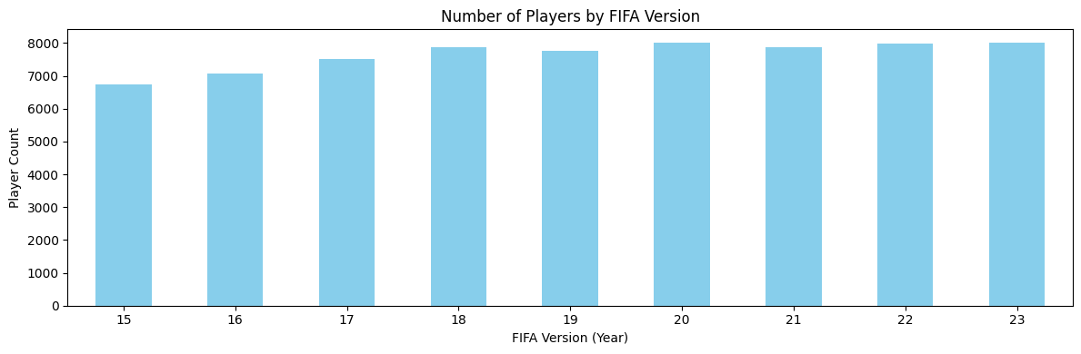
🔍 Exploratory Data Analysis
📊 Key Insight
The number of players with complete attribute data is consistent across versions (~6,800 - 8,000)
The dataset is balanced → no year dominates the analysis
Provides a stable foundation for reliable time-series comparisons
📌 This consistency validates the dataset's structure and supports longitudinal trend analysis across FIFA versions.

Slide 7
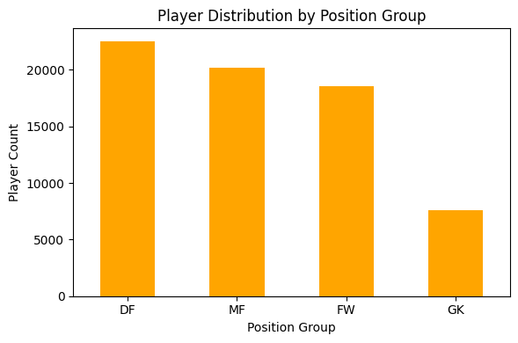
🔍 Exploratory Data Analysis
🛡️ Defenders (DF): largest group → diverse defensive roles
🧠 Midfielders (MF) & 🎯 Forwards (FW): balanced and well-represented
🧤 Goalkeepers (GK): ~7,000 → smallest group, as expected
✅ Why It Matters
Balanced dataset allows for robust position-based analysis
Sufficient player count for each role ensures model reliability
⚽ Fun Insight
Based on player counts, the most reflected formation is 4-3-3 — 4 Defenders – 3 Midfielders – 3 Forwards. Quite telling, isn’t it?

Slide 8
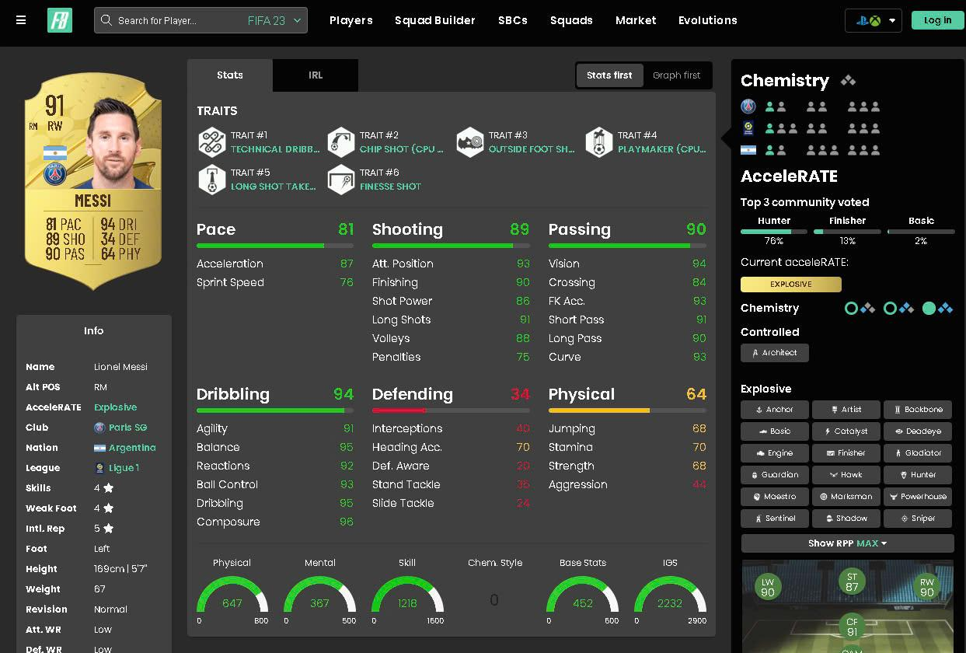
🔍 Exploratory Data Analysis
📐 EA’s Attribute Structure
According to EA Sports, overall rating is computed as an average of main attributes, which themselves are averaged from detailed attributes.
➡️ Therefore, we focus our EDA at the main attribute level, then drill down into detailed metrics when needed.

Slide 9
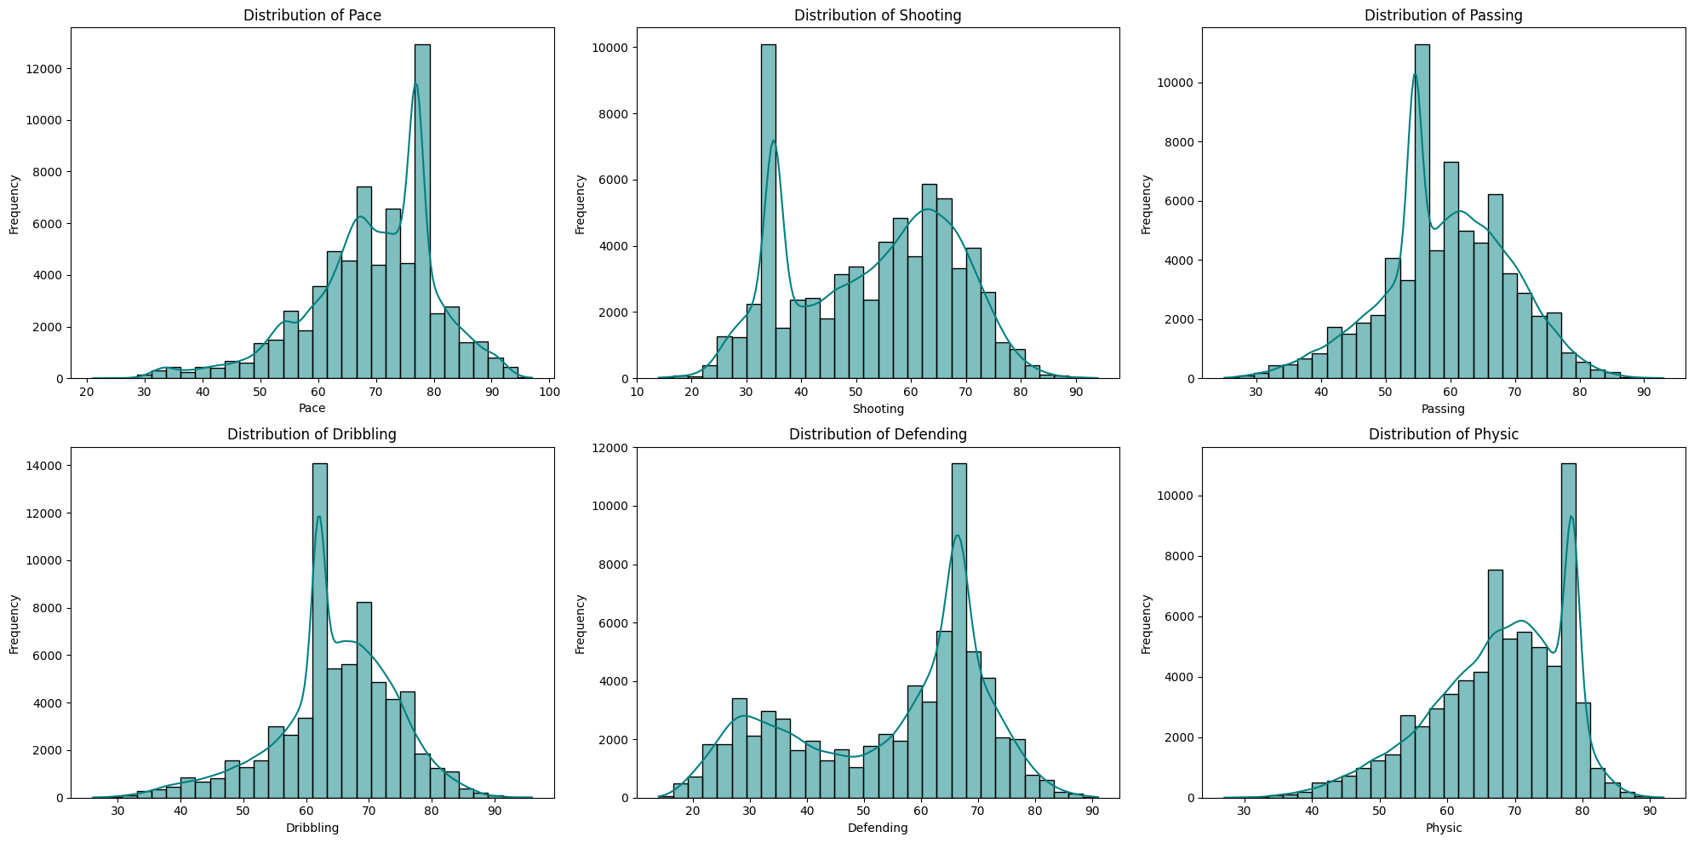
🔹Distribution of main attributes
📌 Attribute distributions reflect role specialization in football: Attackers and defenders show clear separation in stats like defending, while core traits like dribbling and passing are more balanced.

Slide 10
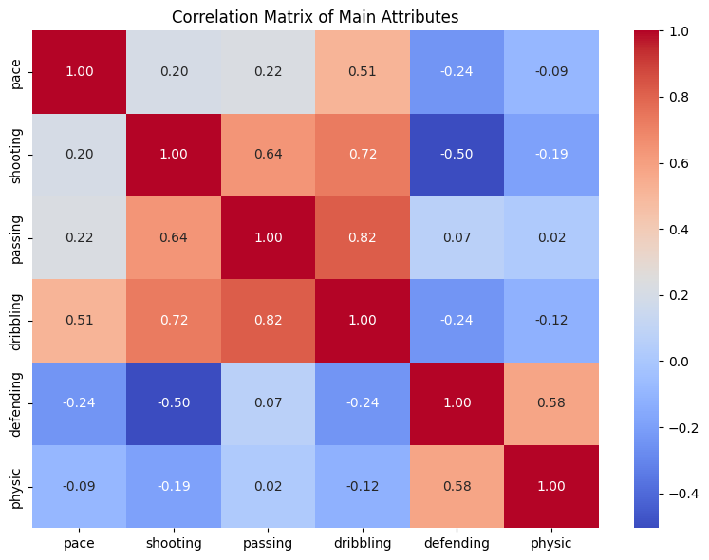
🔹 Correlation matrix of Main Attributes
📊 Key Observations:
Passing – Dribbling: 0.82 → Strong link among playmakers (CAM, CM)
Shooting – Dribbling: 0.72 → Common in technical attackers
Shooting – Defending: -0.50 → Strikers rarely excel in defense
Defending – Physic: 0.58 → Strong physical traits in defenders (CB, CDM)
Pace – Dribbling: 0.51 → Typical of fast wingers
🧠 Insight
Players tend to cluster into two groups:
Attacking-Technical: Dribbling, Passing, Shooting, Pace
Defensive-Physical: Defending, Physic

Slide 11
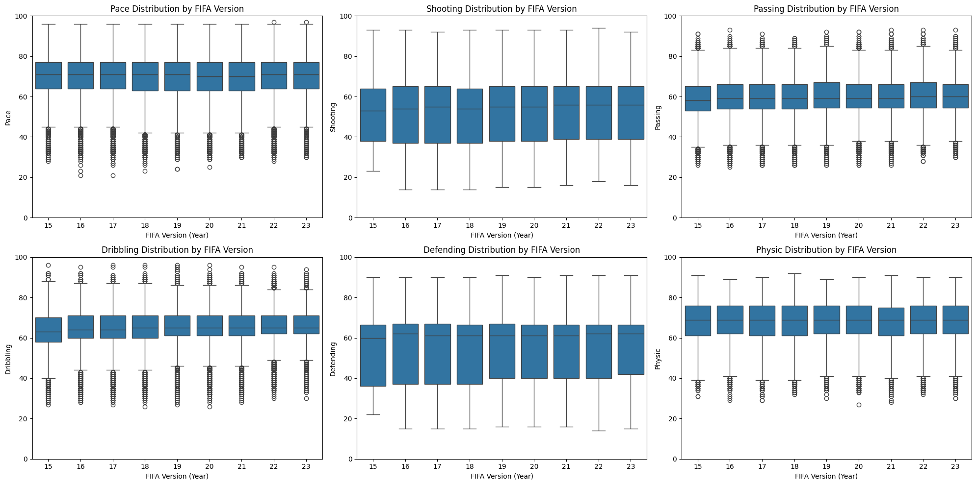
🔹Distribution of main attributes
The dataset is well-structured, stable over time, and clearly stratified — suitable for modeling without major cleaning.

Slide 12
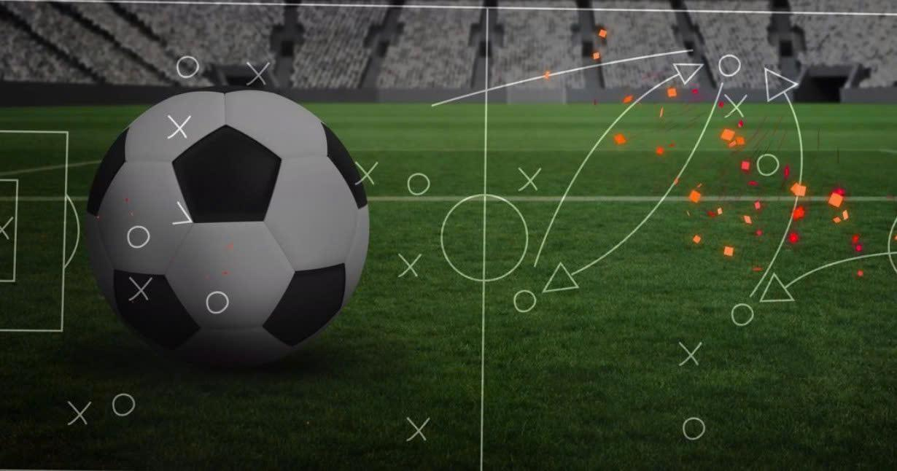
Part 1 - Tactical Shift Over Time

Slide 13
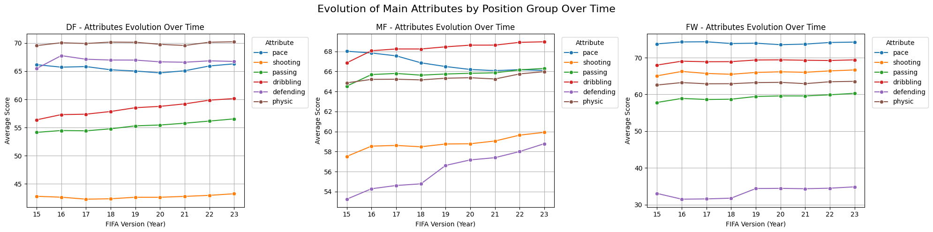
🔹 Which position has evolved the most in modern football?
🔁 Evolving Roles in Modern Football
🧠 Midfielders: Defensive stats ↑ → Reflects pressing & box-to-box roles
⚡ Pace: Still key for DF & FW (pressing, transitions); ↓ in MF → Focus shifts to control
🔄 Versatility: Slight rise in non-core traits → More well-rounded players
🧩 Core Strengths Stay: Role-specific skills still define success
✅ Insight: Modern football demands pressing, pace, and versatility — but positional specialization remains vital.

Slide 14
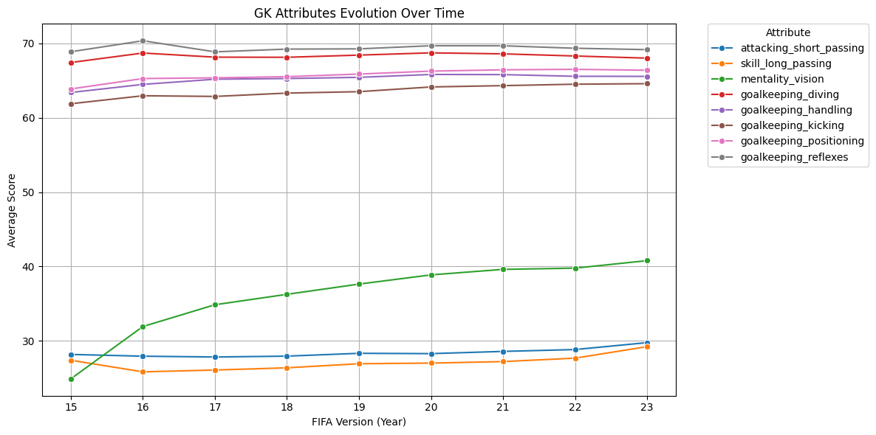
🔹 Tactical Change in Playing Style
Modern goalkeepers must be good at both technical skills and coordination, becoming the "first initiator of attack".

Slide 15
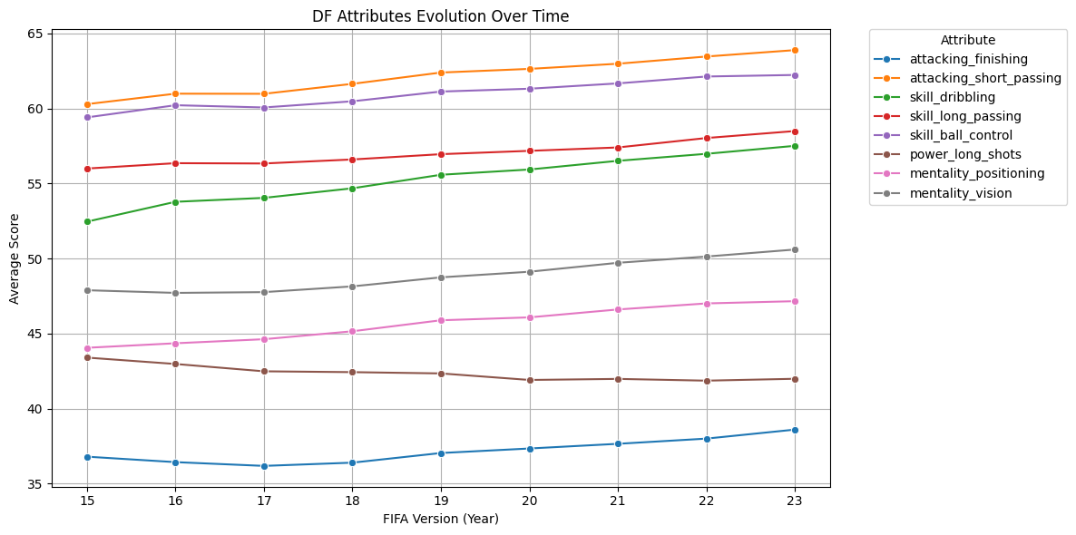
🔹 Tactical Change in Playing Style
The trend of ball-playing defenders is becoming more and more obvious, they not only defend but also participate in build-up play, distributing the ball from the back line.

Slide 16
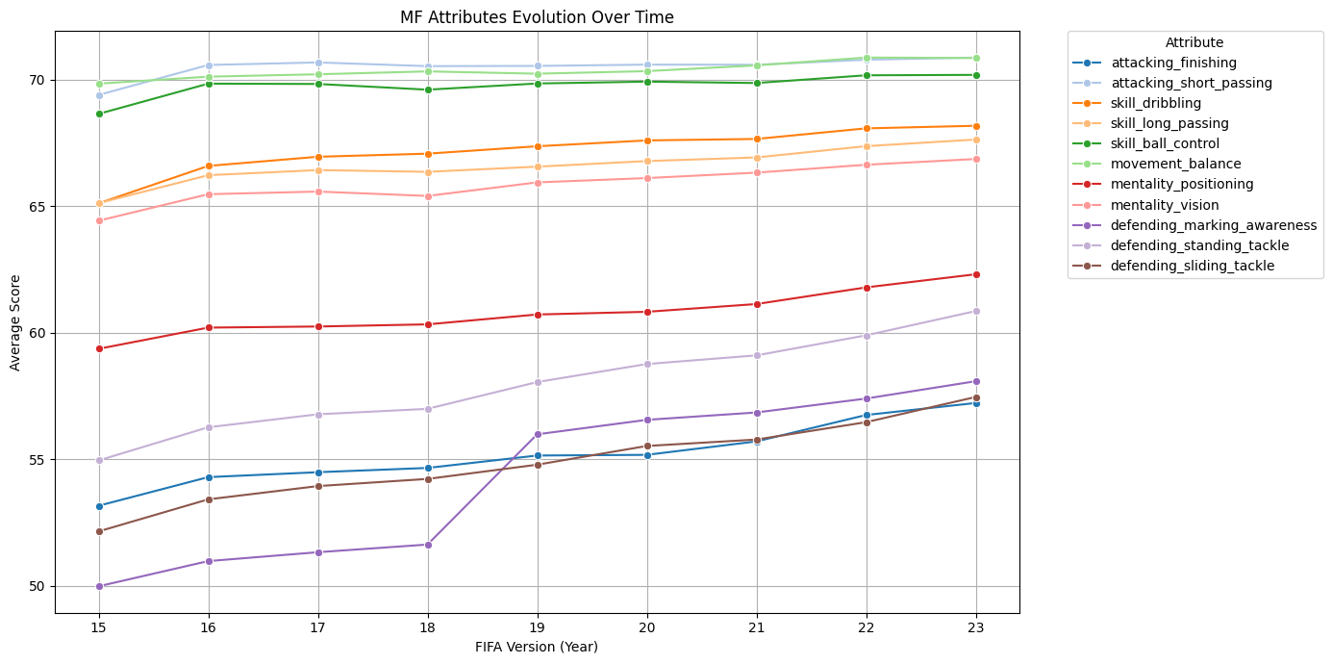
🔹 Tactical Change in Playing Style
Shows the emergence of complete midfielders – both offensive and defensive, and controlling the tempo of the match.

Slide 17
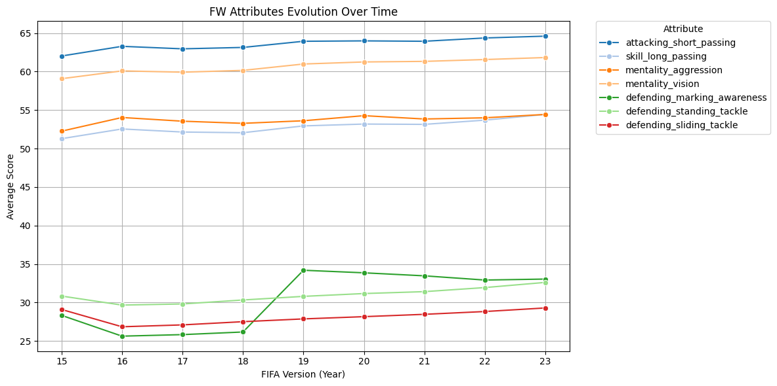
🔹 Tactical Change in Playing Style
Forwards in modern football are no longer "poachers" who just wait for the ball but are also the first link in the defensive system.

Slide 18
🔹 Tactical Evolution – Key Conclusion
📌 Conclusion
In modern football, every position has evolved to meet the demands of faster pace and more complex tactics.
However, the most revolutionary changes are seen in:
🧤 Goalkeepers (GK): From pure shot-stoppers to play initiators
🛡️ Defenders (especially Full-Backs): Now act as creators, runners, and pressers
➡️ These roles have expanded far beyond their traditional definitions, making them the symbol of tactical transformation in today’s game.

Slide 19
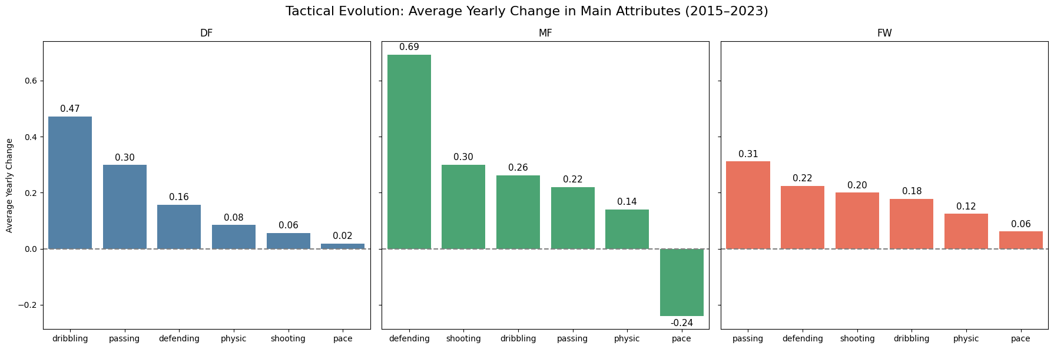
🔹 Key Attribute Changes by Position (2015–2023)
Modern defenders now help build from the back, not just clear the ball
Midfielders Reflects trend of box-to-box midfielders: organize play + intercept + press
Forwards now press from the front and support build-up, not just finish
Modern football favors movement, vision & positioning over raw speed (pace)
📌 Conclusion
Dribbling, Defending, and Passing have changed the most.
Modern football demands versatile players who contribute to team structure, not just shine in isolated roles.

Slide 20
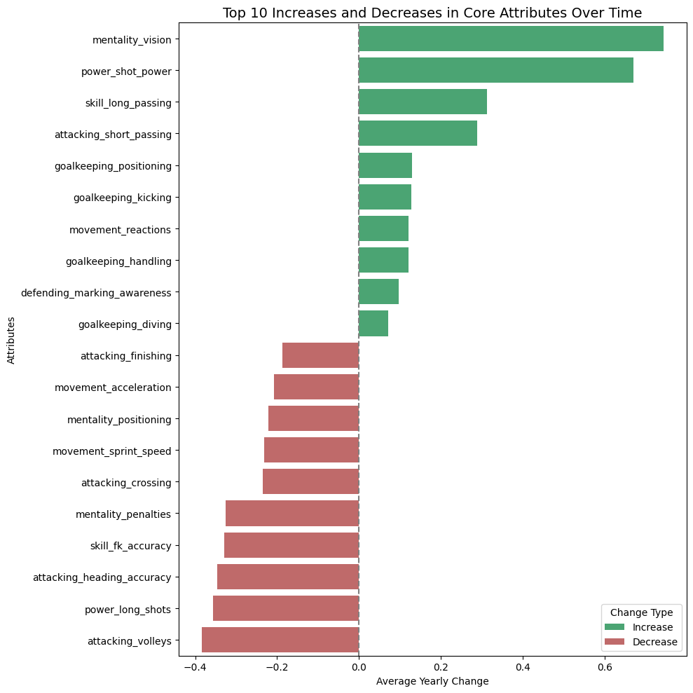
🔹 Tactical Shift in Modern Football (2015–2023)
⚽ Tactical Evolution in Modern Football
🔄 From direct scoring → Structured build-up play
⛔ Less reliance on aerials & wide crosses
📉 Shift away from classic Anglo-Saxon styles
🧠 Emphasis on pressing & positional play: build from the back, escape pressure, close space
🧤 Modern GKs = shot-stoppers + playmakers → a save often equals a goal at top level
📌 Conclusion: Football is now system-driven. Players must be flexible, versatile, and tactically aware — not just excel in isolated roles.

Slide 21
🔧 Recommendations
⚽ Coaches
Train players for multi-role adaptability (e.g. defenders with passing, midfielders with tackling).
Design systems around pressing, build-up play, and fluid positioning.
Leverage hybrid roles (e.g. inverted full-backs, complete midfielders).
🕵️ Scouting
Prioritize players with non-traditional strengths (e.g. dribbling defenders, pressing forwards).
Look for tactically intelligent profiles: high vision, awareness, reactions.
Use trend insights to spot undervalued talent fitting modern roles.
📊 Analysts
Update attribute benchmarks by position (e.g. passing for CBs, defending for STs).
Quantify how versatility impacts performance across systems.
Track evolution of player profiles to support squad planning.
🧠 Modern success comes from synchronized versatility, not rigid specialization.

Slide 22
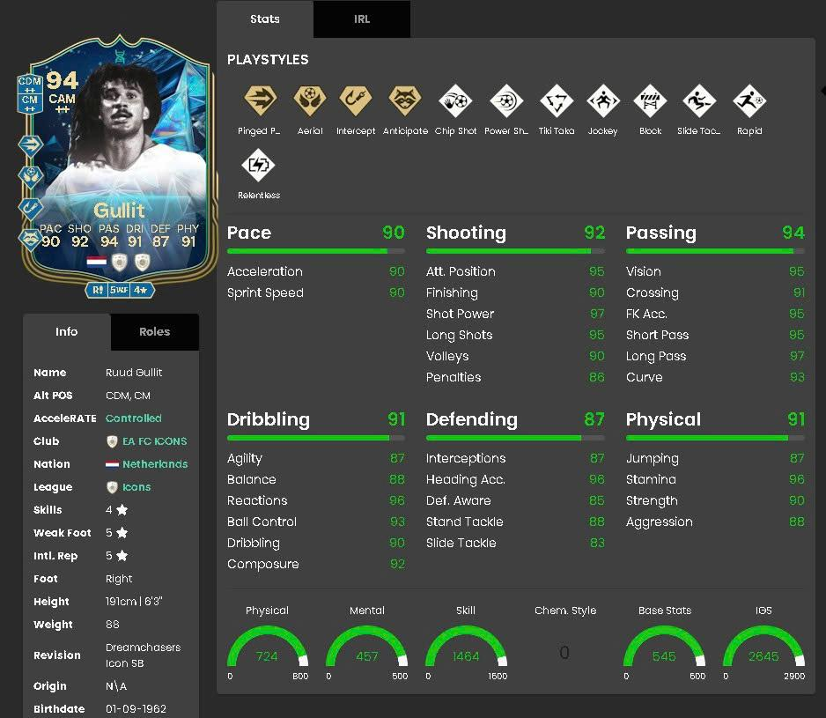
Part 2 – The Making of Great Players
This study focuses on in-game attributes only, not real-life performance metrics.
WHO IS HE?

Slide 23
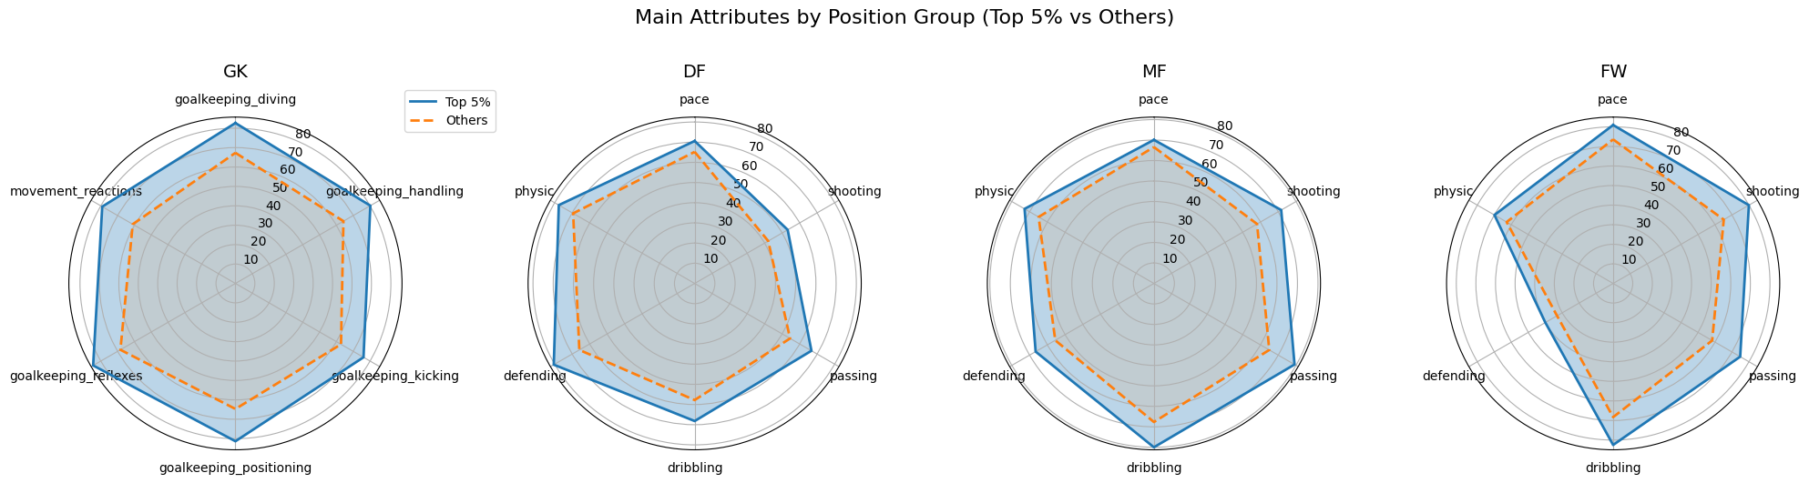
🔹 What main attributes make great players?
🧤 A complete goalkeeper needs sharp reactions and positional mastery
🛡️ Excellent defenders initiate build-up, not just clear the ball
🧠 Great midfielder controls tempo, create & finish chances
🎯 Top forwards decide games with creativity & finishing ability
📌 Note: Radar charts highlight clear attribute separation between top 5% and another players in each role.

Slide 24
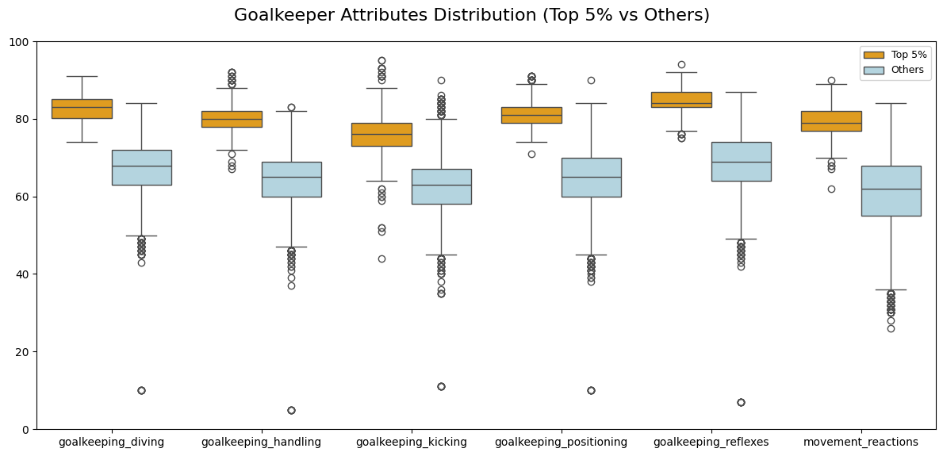
🔹 What Makes Great Goalkeepers?
➤ Well-rounded skill set: Not just specialists — they’re consistently good across the board
➤ High consistency: Low variability , stable performance even under pressure
➤ Reflexes & Reactions are the most differentiating factors, these traits define legendary saves and split world-class GKs from the rest

Slide 25
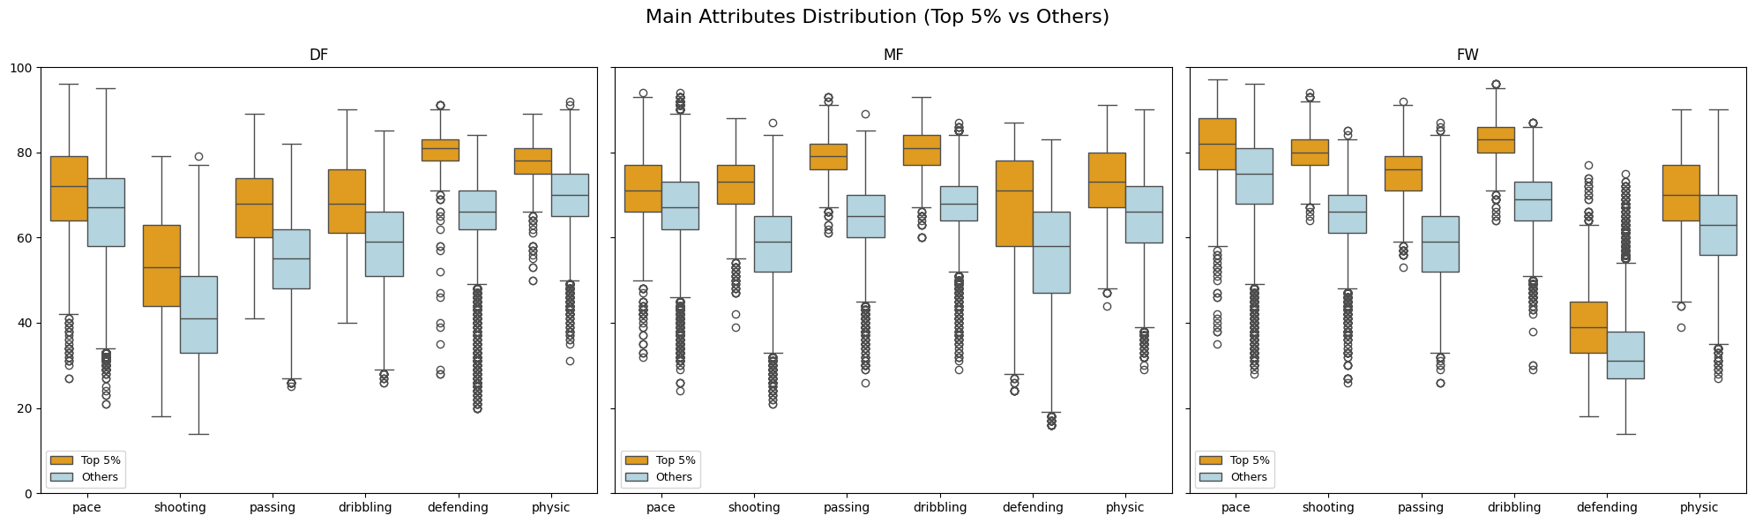
🔹 What Makes Great Players?
🧠 Top 5% players outperform the rest in both skill level and consistency, more reliable performance. They’re well-rounded, not just strong in one stat
🛡️ Great defenders support both defense & build-up with technique
🎮 Great midfielders are versatile engines — assist, defend, and control match
🎯 Great forwards are not just scorers, but also skilled and fast
📌 Across all roles, top players combine excellence in core skills with consistency and versatility — the foundation of football greatness.

Slide 26
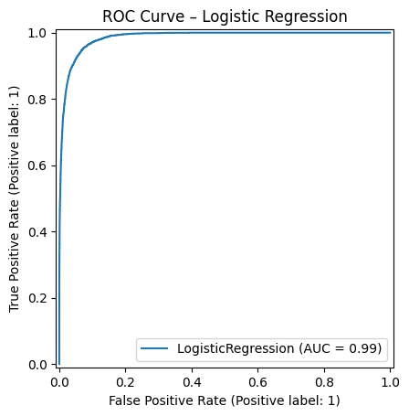
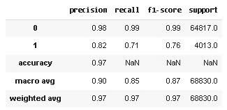
🔹 What core attributes make great players?
Based on FIFA player attributes, what are the core features that distinguish top 5% players from the rest?
To analyze this we will use a logistic regression model to distinguish the great players (top 5%) from the rest.
After determining the core attributes, we will train the model and evaluate it based on the classification report and the ROC Curve graph.
✅ Logistic Regression Model Easy to understand, simple, shows very good efficiency in classifying "great players". Used to determine the core attributes that make a great player (via coefficients).

Slide 27
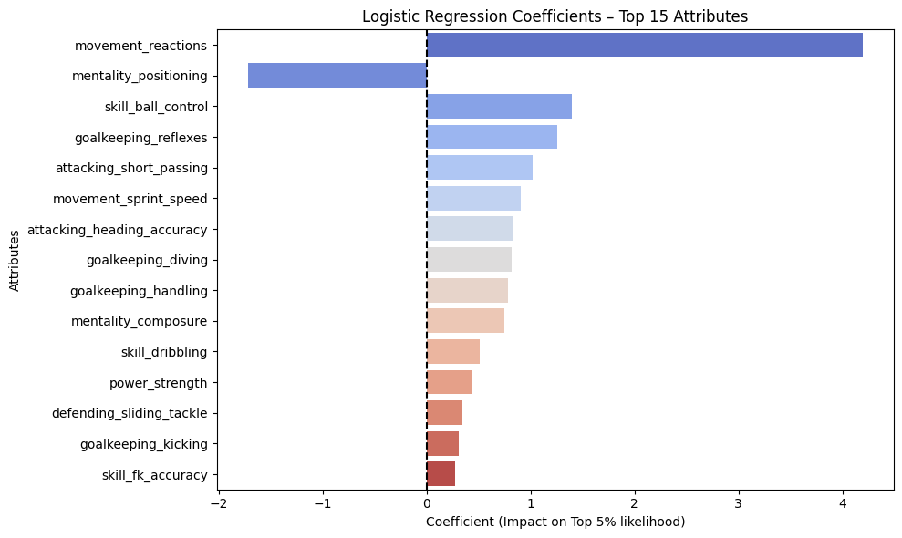
🔹 Core Attributes of Great Players
💡 Top Attributes of Elite Players (by Model Coefficients)
⚡ Reactions: Quick decisions in tight moments
🎯 Ball Control & Passing: Key for build-up play
🧠 Reflexes: Elite goalkeepers stand out
🏃‍♂️ Sprint Speed & Heading: Common in top forwards
📉 Positioning: Negative impact — varies by role
✅ Conclusion: Top players blend speed, control, and role-specific strengths — explaining the dominance of midfielders & forwards in modern football.

Slide 28
🧠 Recommendations
🧑‍🏫 For Coaches
🔄 Train reactions & ball control early – key across all positions
🧩 Develop well-rounded skill sets – not just role-specific
🎯 Focus on: Reflexes, Reactions (GK); Short Passing, Dribbling (MF); Sprint Speed, Heading Accuracy (FW)
🕵️‍♂️ For Scouts
✅ Look for consistency across attributes, not just standout stats
⚡ Reactions are a strong predictor of elite performance
🧠 Use role-specific benchmarks when evaluating talent
📊 For Analysts
⚠️ Adjust for positional bias (e.g. Positioning ≠ always good)
📉 Track performance variability – top players = low spread
🔍 Use multi-attribute profiles to spot underrated gems
⭐ Key Takeaway
Great players are not just exceptional, but consistently excellent
→ They combine technique, speed, and quick decision-making – in the right context.

Slide 29

Part 3 - Market Pulse: Underrated vs Overrated

Slide 30
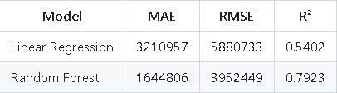
🔹 What factors greatly affect a player's value?
✅ Random Forest – Strong Performance
Great fit for complex, noisy data like FIFA.
Low average error compared to market range.
⚠️ Linear Regression – Underfitting
Fails to capture non-linear relationships in player data.
Sensitive to outliers, less reliable for prediction.
🧠 Key Takeaway
🎯 Random Forest significantly outperforms Linear Regression Ideal for modeling real-life player values, where attributes interact in nonlinear and complex ways.

Slide 31
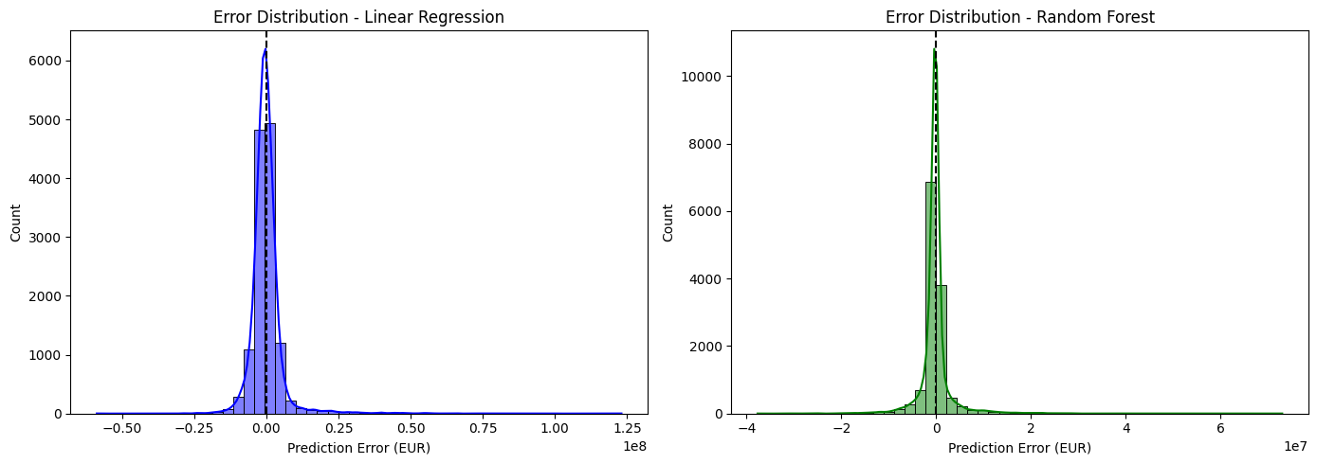
🔹 Modeling Approach: Predicting Player Value
Random Forest outperforms Linear Regression in both accuracy and consistency.
It handles non-linear patterns and outliers much better, making it more suitable for player value prediction.

Slide 32
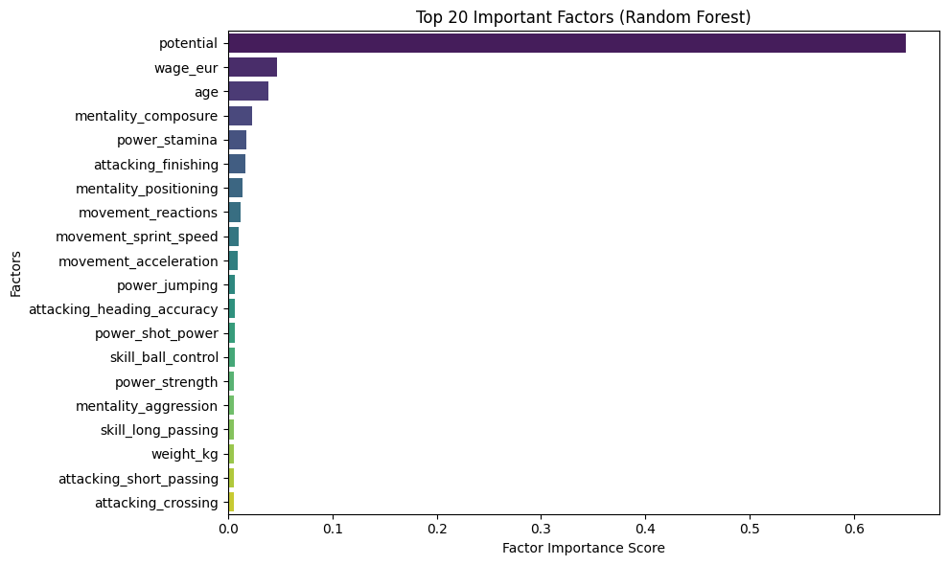
🔹 Feature Importance for Player Value
(According to Random Forest model)
🥇 #1 – Potential: Most dominant factor
➤ Reflects market focus on future development over current ability → Explains high fees for young talents
🥈 #2 – Wage: Strongly correlated with market value
➤ Indicates player’s current role & recognition in the club
🥉 #3 – Age: Younger players are more valuable due to longer career horizon
🔑 Mental & Physical Traits: Attributes like composure, stamina, sprint speed, acceleration, reactions → Critical for attackers & midfielders, who dominate the market value scale
✅ Summary Insight
Strategic attributes (potential, age, wage, fitness, composure) ⟶ More influential than raw technical skills ⚽ Clubs invest in future growth, not just current ability

Slide 33
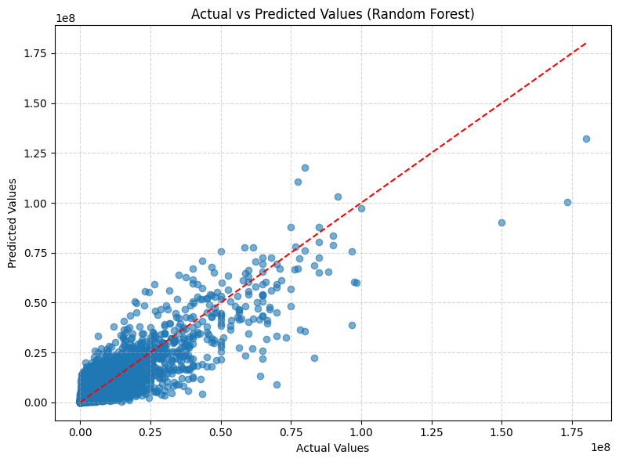
🔹 Can we approximate real-world player value?
✅ Strong Alignment with Reality
➤ Most points lie close to the diagonal
→ Indicates the model effectively captures the relationship between player attributes and market value
🔄 Better than Linear Regression
➤ Random Forest handles non-linear patterns
➤ Fewer systematic errors, stronger generalization
⚠️ Underestimation at the Top End
➤ Players valued above €100M tend to be undervalued by the model likely due to:
Data imbalance (few ultra-high value players)
Missing intangible factors: media influence, branding, legacy

Slide 34
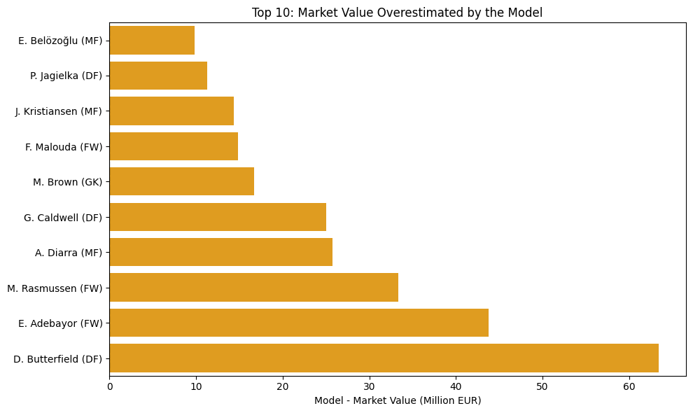
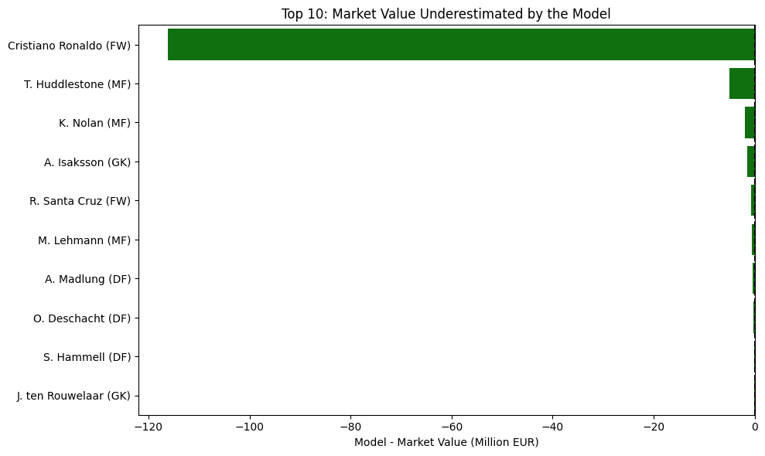
🔹 Overestimated & Underestimated Players
🔼 Overestimated by Model ➤ Model > Market → Strong attributes, but players past their prime → Model misses off-pitch factors (e.g., injury, recent form, transfer noise) → Real-world prices shaped by club strategies, market trends, media impact
🔽 Underestimated by Model ➤ Model < Market → Example: Cristiano Ronaldo → Model ignores brand value, legacy, and commercial appeal → Market sees off-field influence as part of total value
✅ Conclusion
🔍 Random Forest = strong technical evaluator
❗ Struggles with intangibles: fame, hype, reputation
💡 Insight: This mismatch reveals where data-driven logic diverges from human perception — and why both matter

Slide 35
Recommendations
1️⃣ For Clubs & Scouting Teams
Focus on long-term indicators: potential, fitness, mentality — not just current skills
Use model to identify undervalued young talents early
Treat the model as a data-driven scouting assistant for smarter investments
2️⃣ For Football Data Analysts
Enrich models with off-pitch factors: injury, form, media & commercial value
Use prediction errors as flags for deeper qualitative review
Build hybrid dashboards combining stats & expert scouting reports
3️⃣ For Executives & Investors
Don’t overpay for hype or reputation not backed by performance
Use model outputs as negotiation benchmarks
Invest in youth + potential = future success & financial sustainability
✅ Final Thought
The model doesn’t replace scouts — it amplifies strategic decisions when paired with human expertise in the dynamic football market.

Slide 36
🧠⚽ Beyond Instinct: Building Smarter Football Decisions
Modern football requires more versatile players
Tactical & market intelligence = data-driven success
Future = hybrid of analytics + expert judgment Call to Action: Embrace football intelligence

Slide 37
Q&A
🙋‍♂️ "Feel free to ask anything!"
“Thank you for your attention!”

